Slide 1

Transport & Travel Wing
Seva Report (Chinchwad Centre - Bhosari,
Mira Society Subzone)

Slide 2

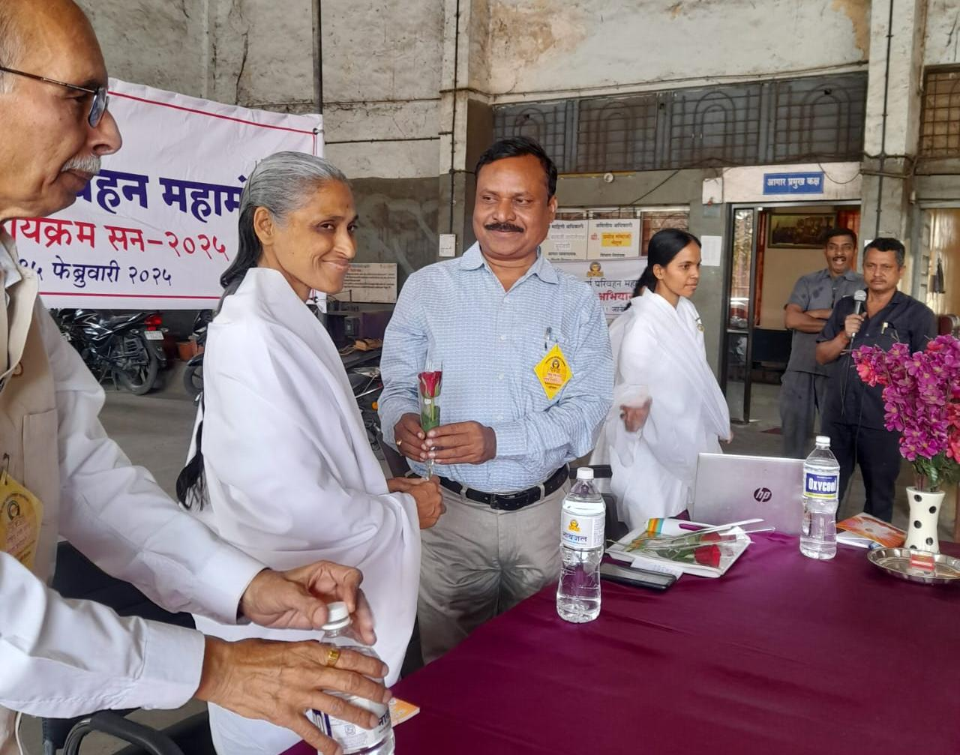
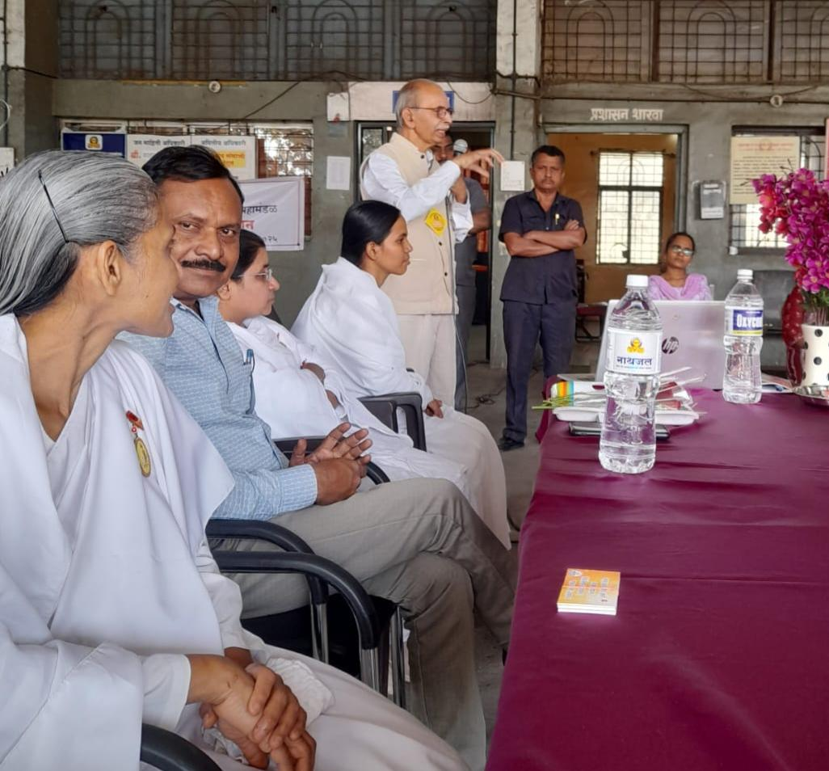
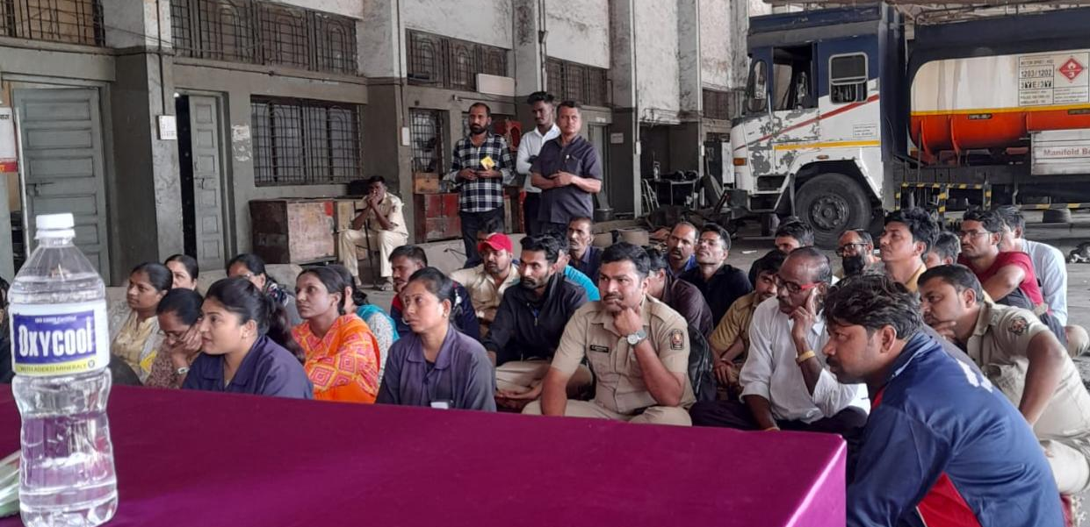
Session 1
Special Session on the occasion of Road safety month
Venue - Maharashtra state transport depot of Vallabhnagar
𝐃𝐚𝐭𝐞 - 16th January 2025
Subject - Sadak Suraksha, Jeevan Raksha
Speaker -
BK Ashwini, BK Bhagyashree and BK Poonam
BK Manvendra Bhai too addressed the meeting.
People - 50+ participants included drivers, conductors of ST buses and the maintenance staff.
The depot in-charge, Shri Suryavanshi, in his speech stressed on the importance of road safety and fuel saving.

Slide 3
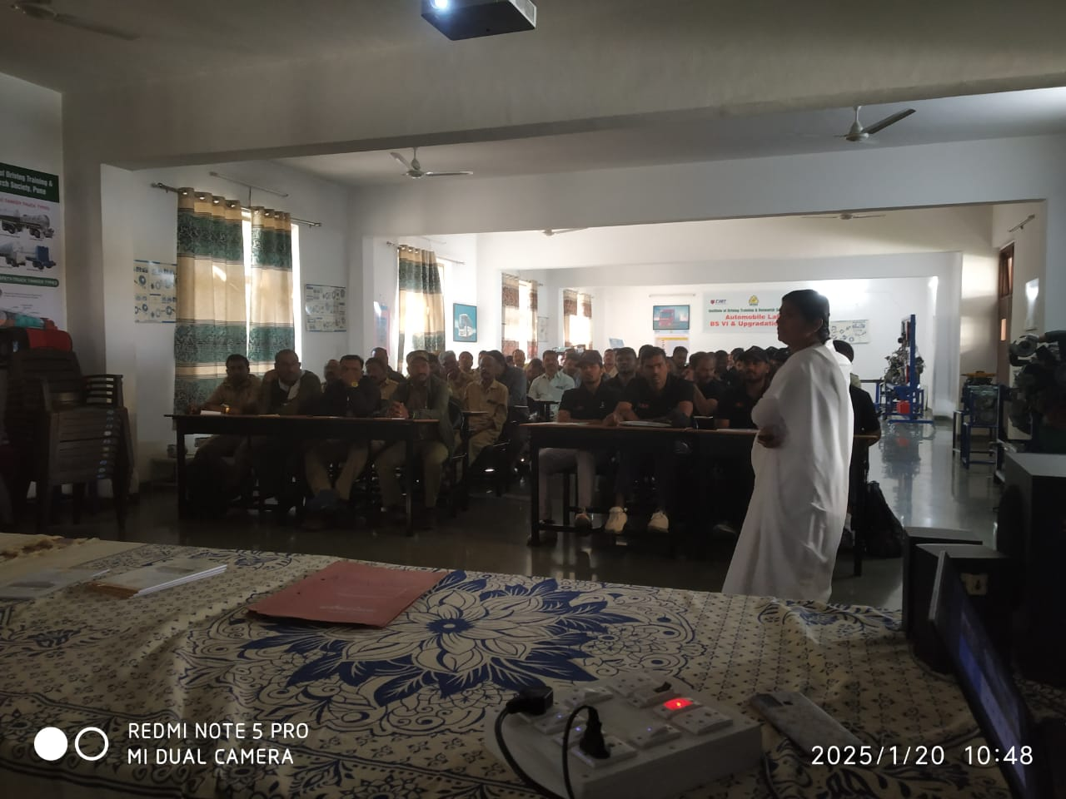
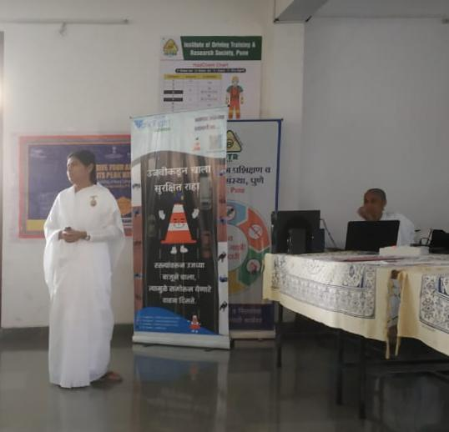
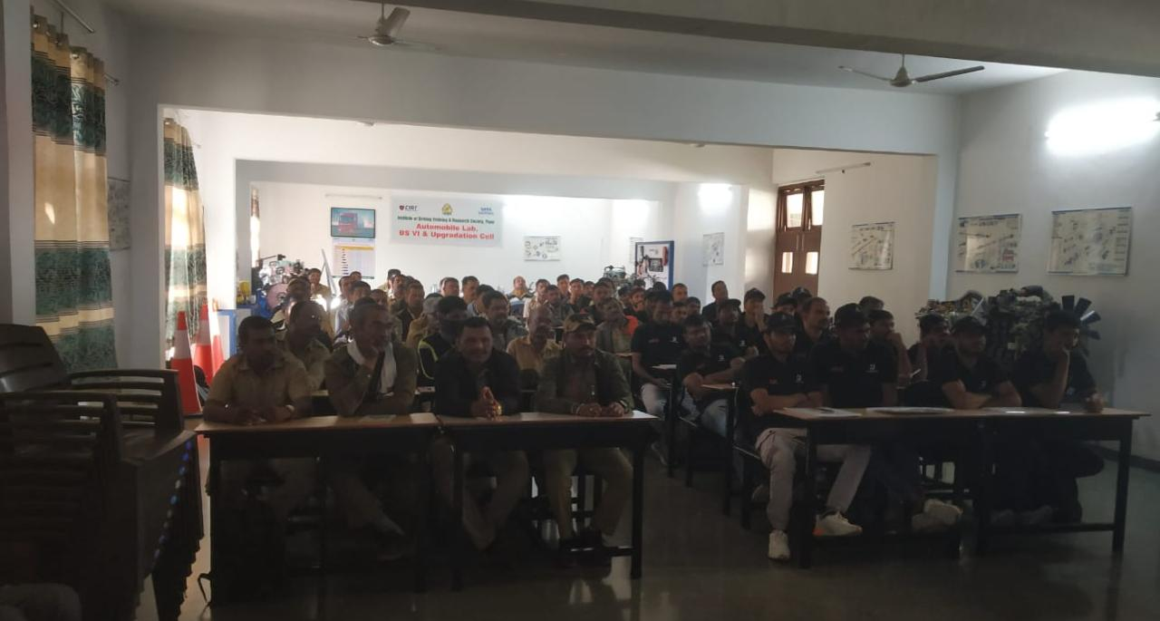
Session 2
Special Session on the occasion of Road safety month
Venue- IDTRS (Institute of Driving Training and Research Society –Pune
𝐃𝐚𝐭𝐞 - 20th January 2025
Subject- Suhana safar
️Speakers -
BK Manjusha conducted a session on “Suhaana Safar. Bk Ashwini didi stressed on Rajyog Meditation during her talk. Bk Manvendra bhai gave introductory talk.
People - 80 Participants from PMPML and Bridgestone
At end of the session the Principal of the Institute asked feedback from participants four of them reported positive feedback.
Shri Umakant Kamluskar Instructor BRO – Border Roads Organization also gave inspiring talk.

Slide 4
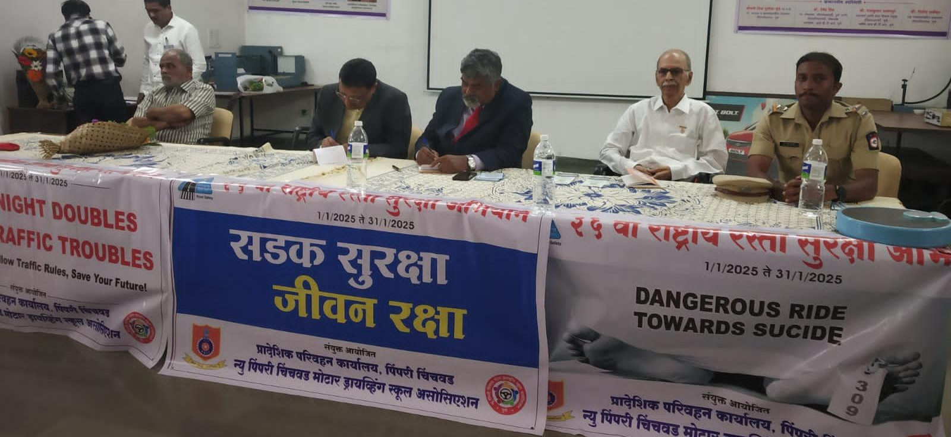
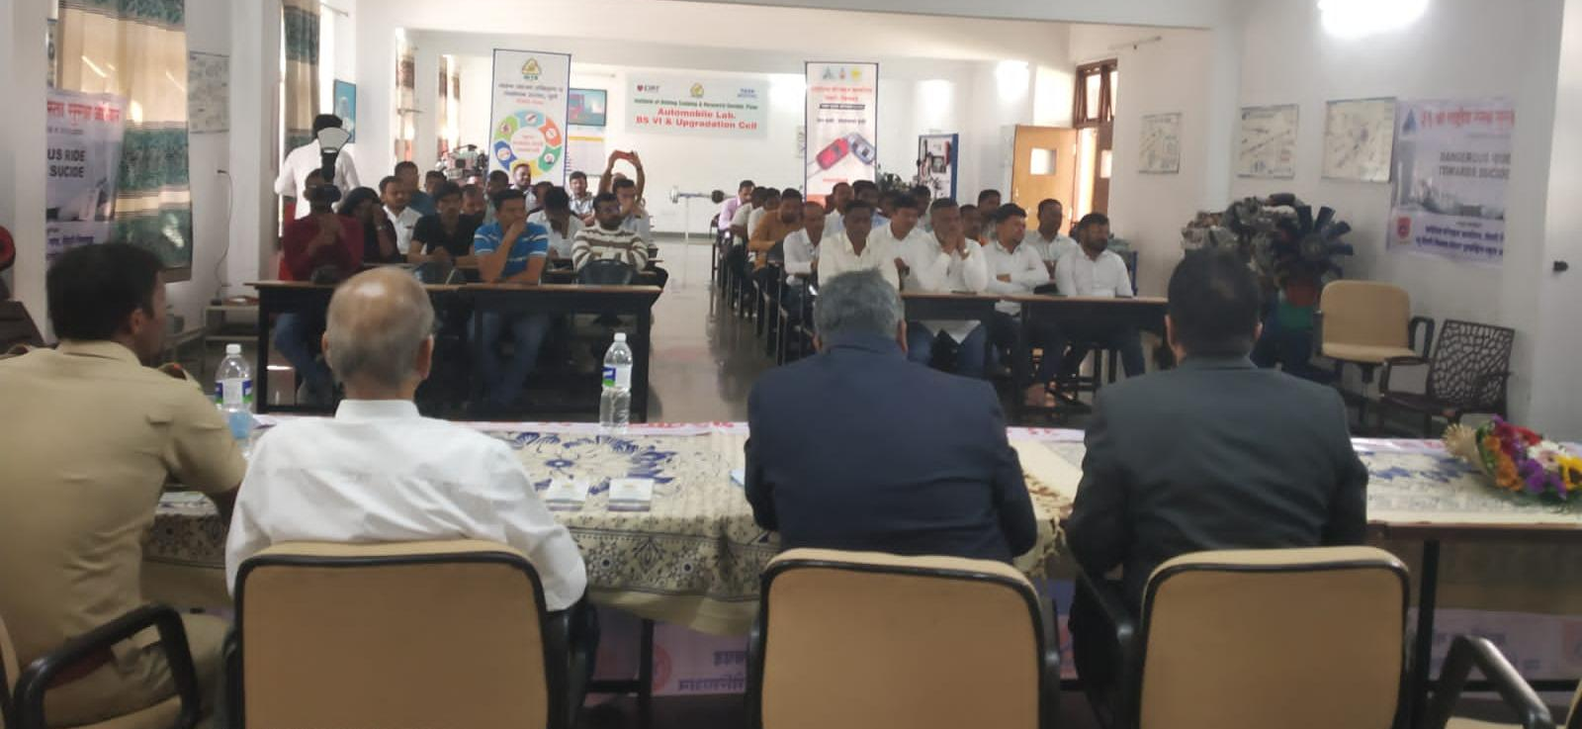
Session 3
Special Session on the occasion of Road safety month
Venue - IDTR institute
𝐃𝐚𝐭𝐞 - 25th January 2025
Subject - Sadak Surksha, Jeevan Raksha
Speaker –Bk Manvendra bhaiji
People - 80+
Special presence- IDTR Principal Sanjay Shahane ji

Slide 5
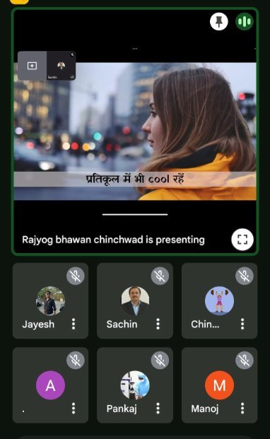
Session 4
Special online Session on the occasion of Road safety month
Venue- Sinhgadh College of engineering
𝐃𝐚𝐭𝐞 - 28th January 2025
Subject - Suhana Safar
Speaker –Bk Akanksha bahen

Slide 6
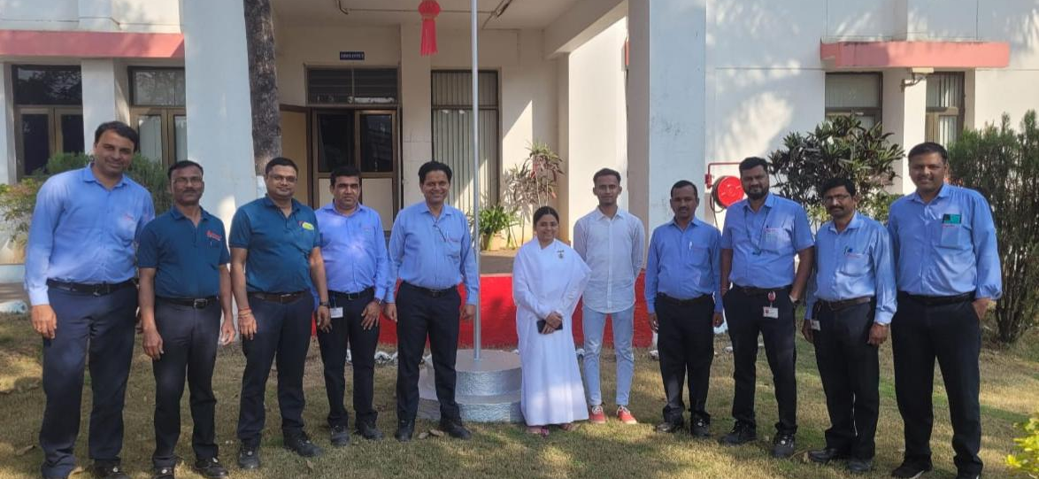
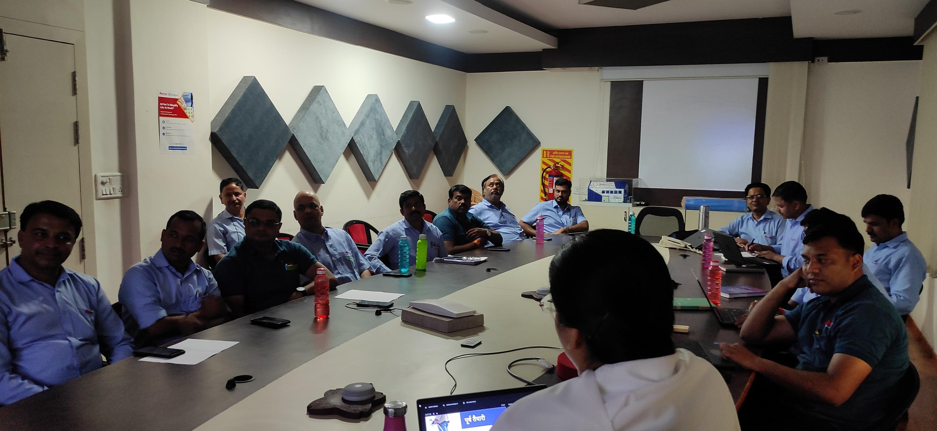
Session 5
Session for staff and Managers
Venue- Supreme Industries company
Speaker - Bk Akanksha bahen
Date – 12th Feb 2025
People - 15+
Subject - Sadak Surksha, Jeevan raksha, Suhana safar
Sevadharis - Bk Akshay bhai

Slide 7
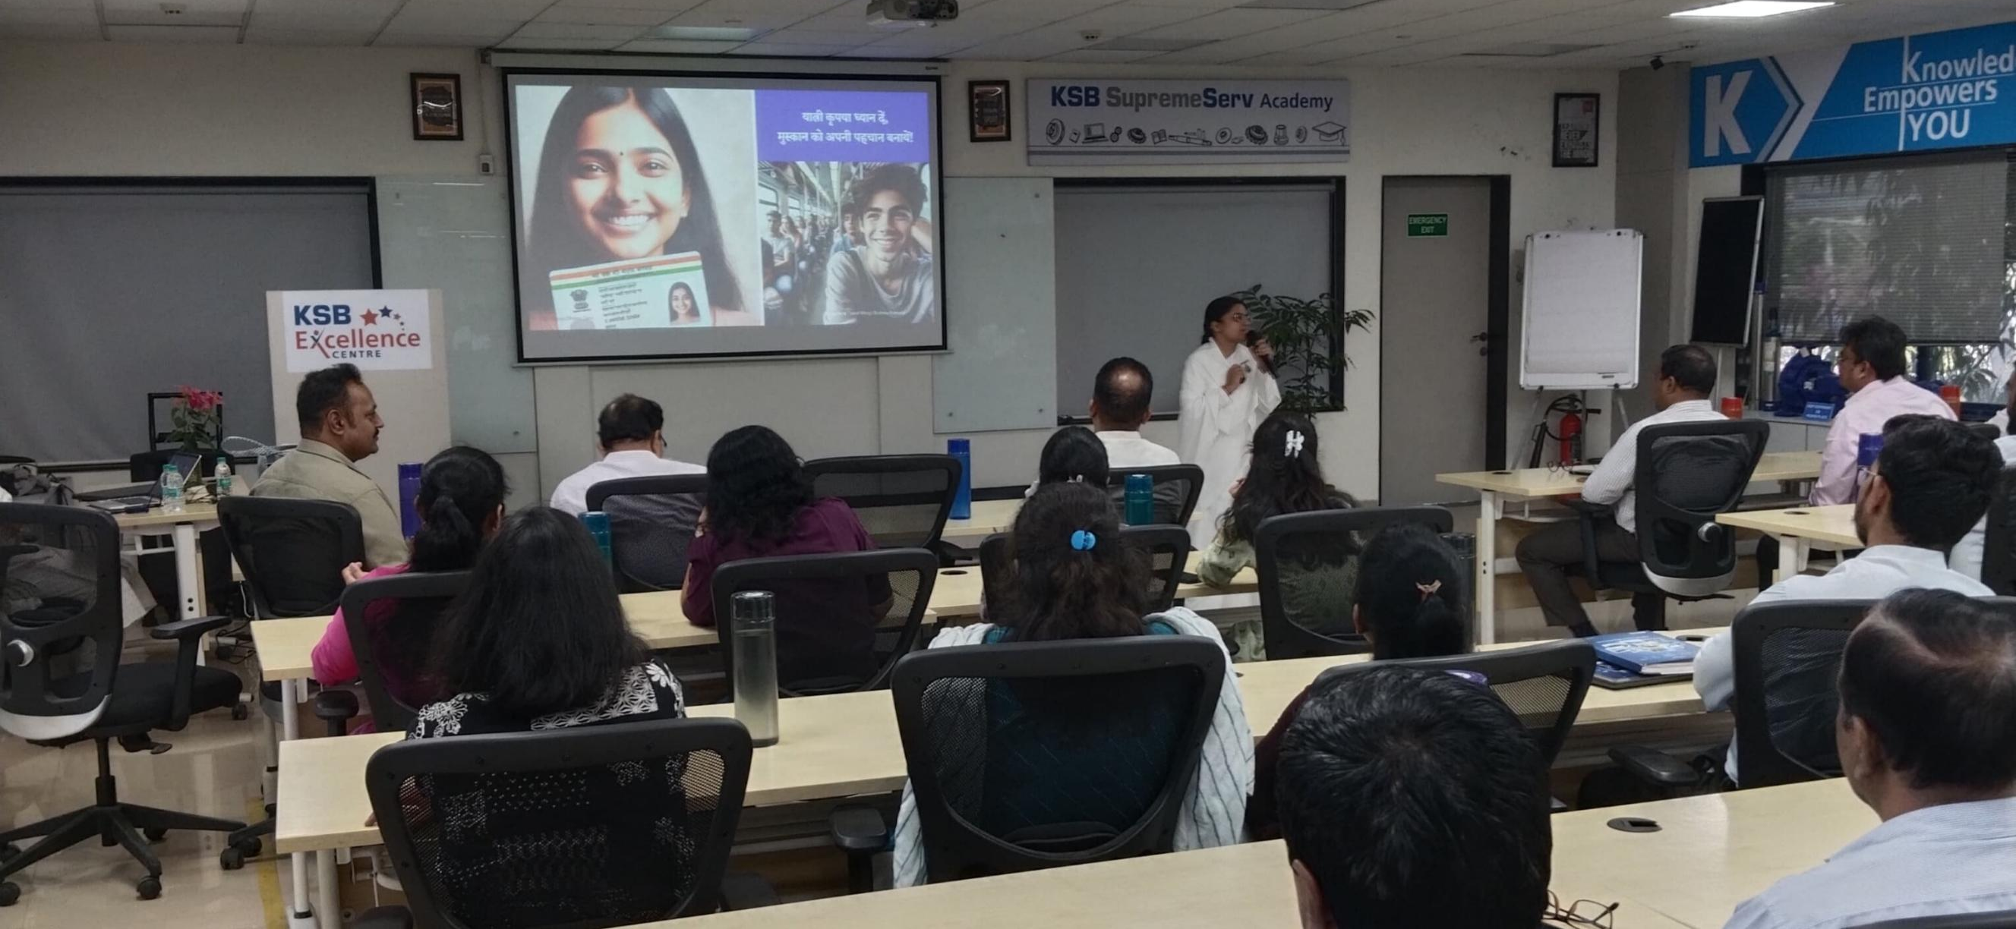
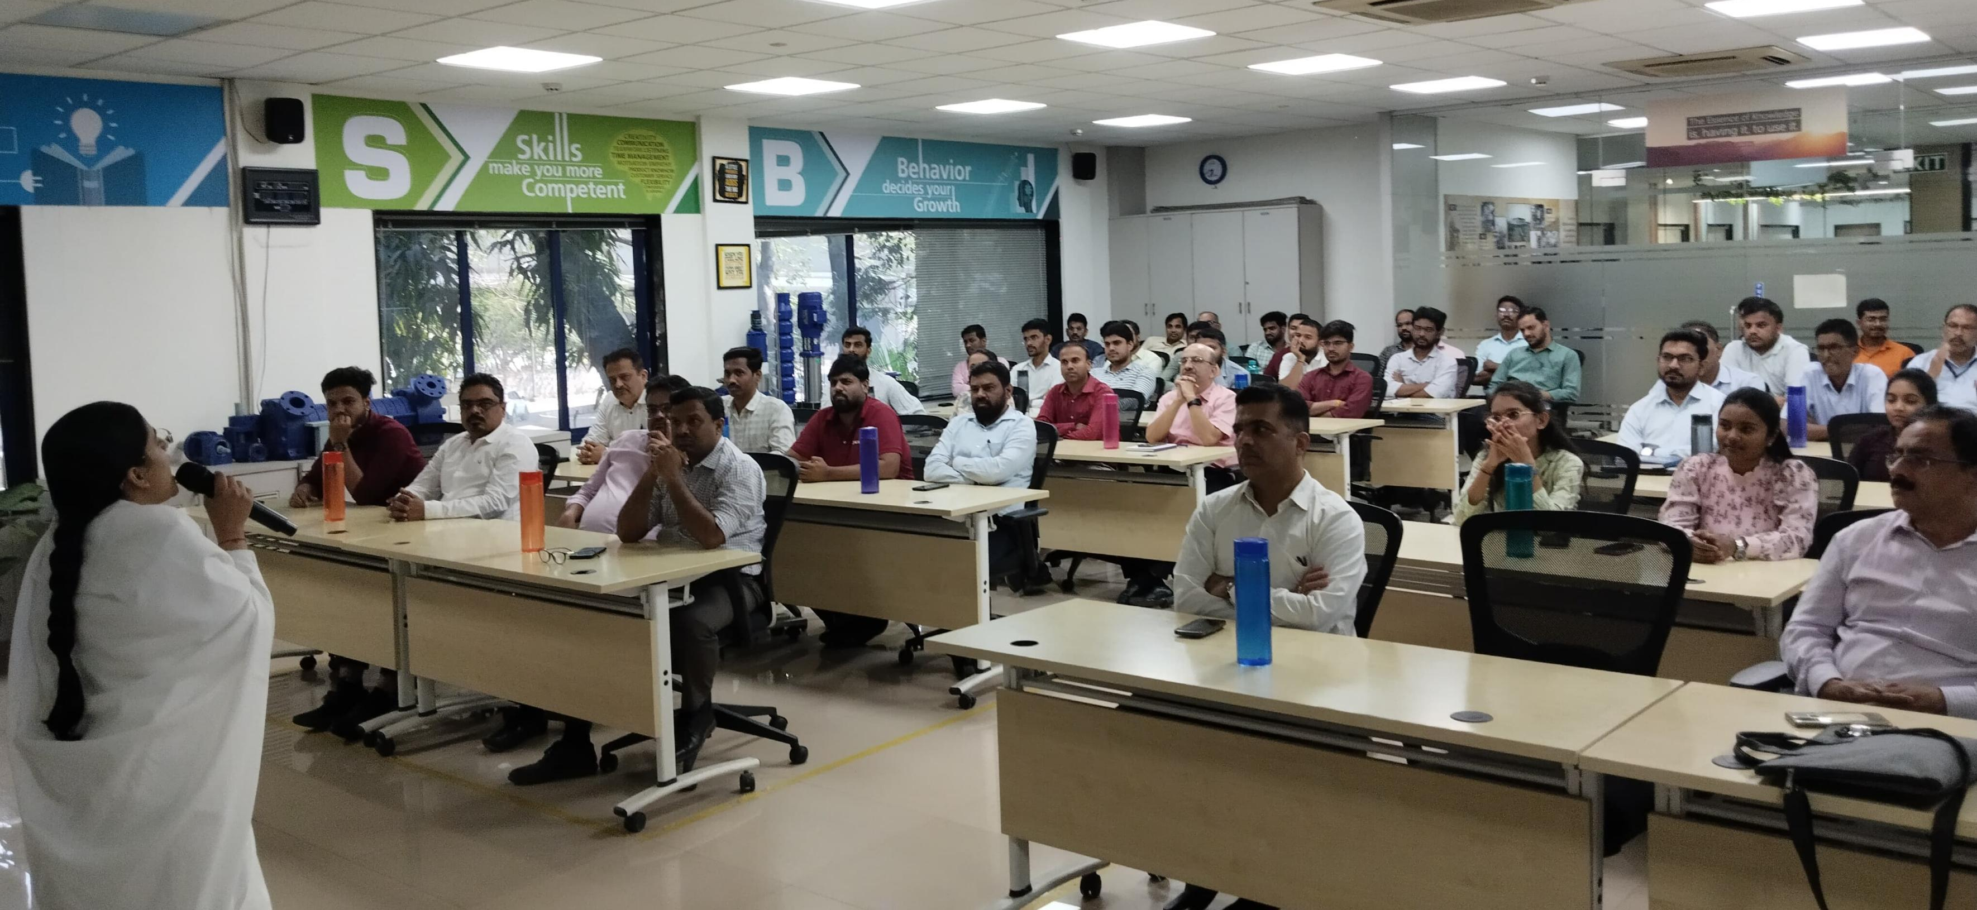
Session 6
Session for Enginners and Managers
Venue - KSB Ltd company, Chinchwad
Date - 19th February 2025
Speaker - Bk Akanksha bahen
People - 60+
Subject - Suhana safar
Sevadharis - Bk Arya bahen
Special thanks to Dr Milind bhaiji for permission
Special thanks to Plant head Mr. Rajesh sir and HR head Mr Ajay sir

Slide 8
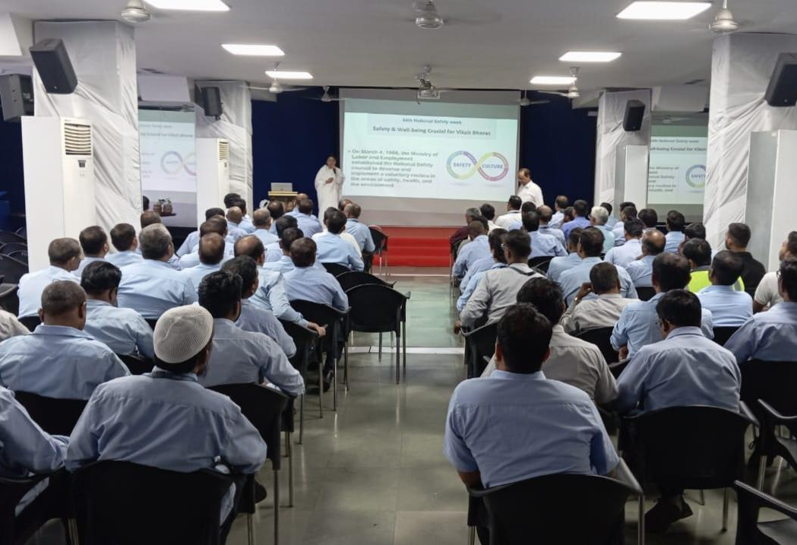
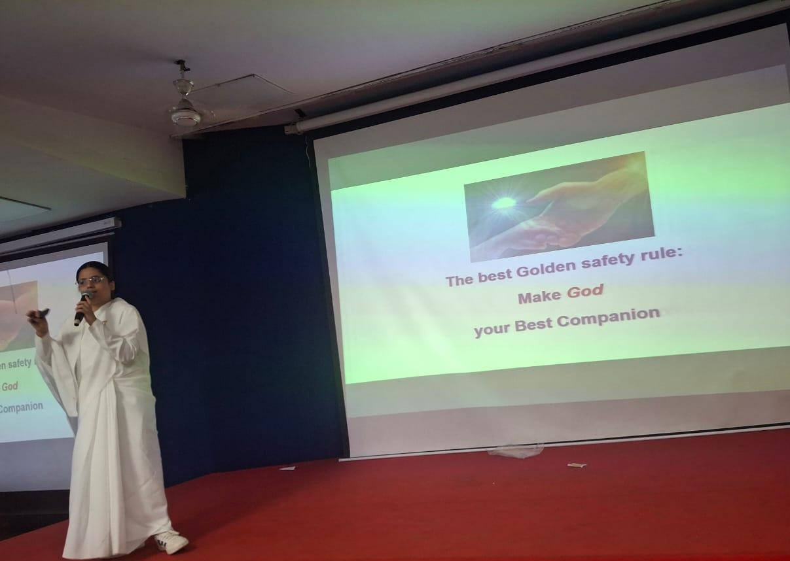
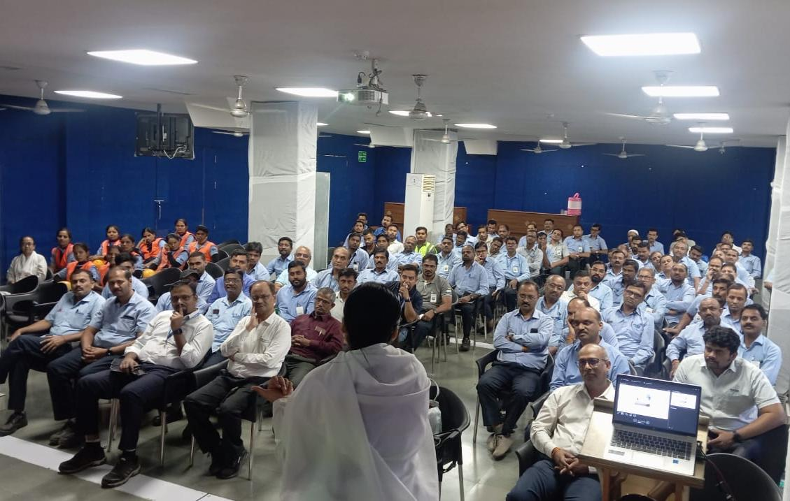
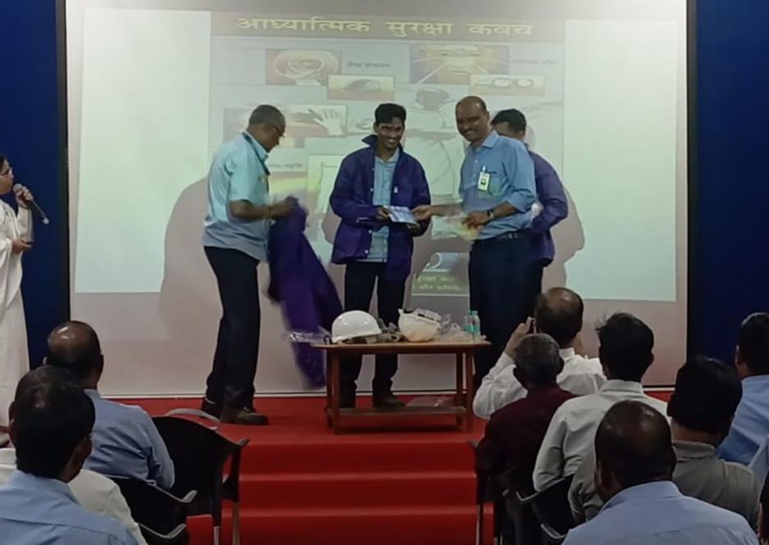
Session 7
Special session on the occasion of Industrial Safety Week
Venue - Tata Motors Company
Date - 6th March 2025
Speaker - Bk Akanksha bahen
People - 150+ employees ( Managers and staff)
Subject - Dynamic safety through spirituality
Sevadharis - Bk Seema mataji & Ajit bhai

Slide 9
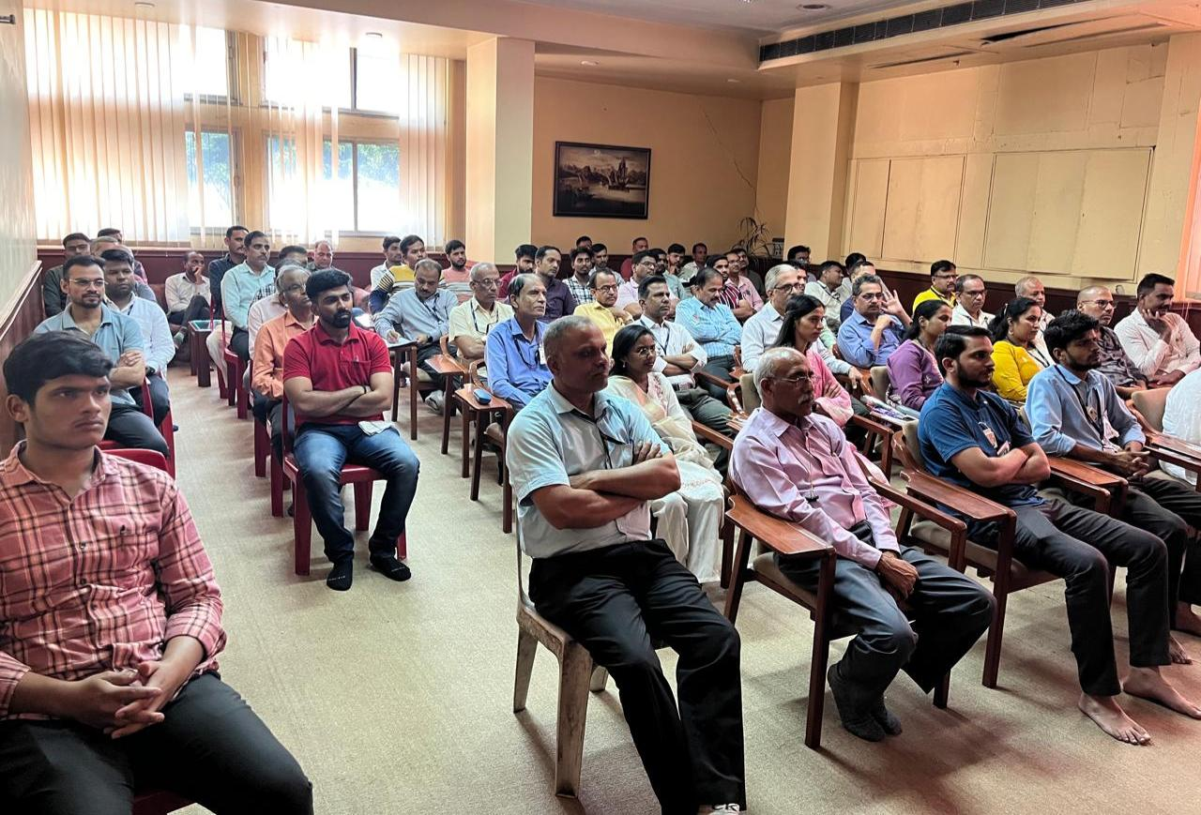
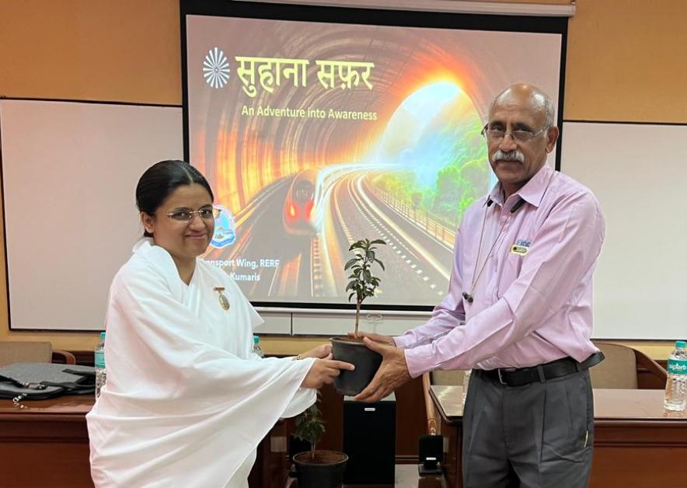
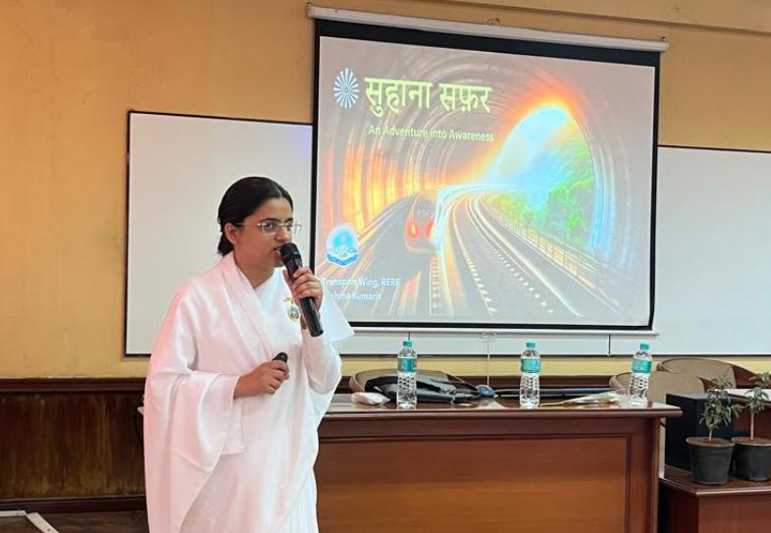
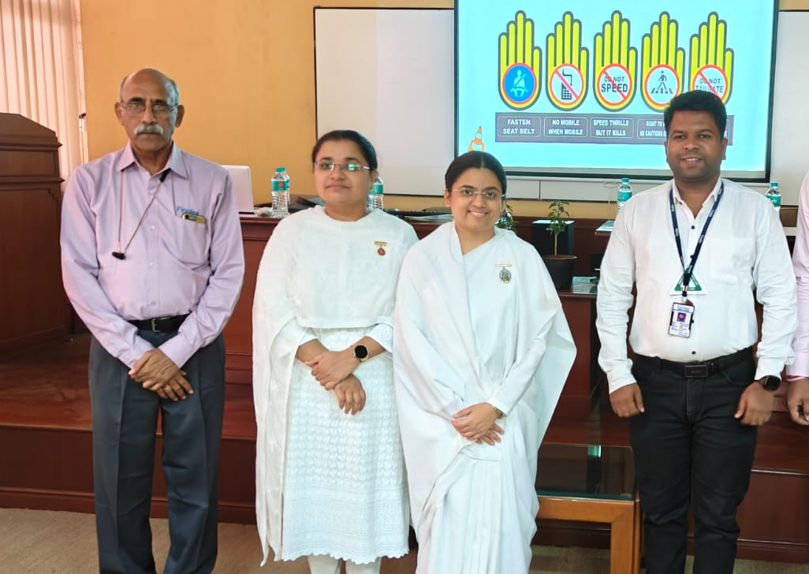
Session 8
Special session on the occasion of Industrial Safety Week
Venue - Finolex Cables ltd Company
Date - 8th March
Speaker - Bk Akanksha Bahen
People - 80 employees ( Managers and staff)
Subject - Suhana Safar
Sevadharis - Bk Bhagyashree bahen
Special thanks to Laxman bhaiji

Slide 10
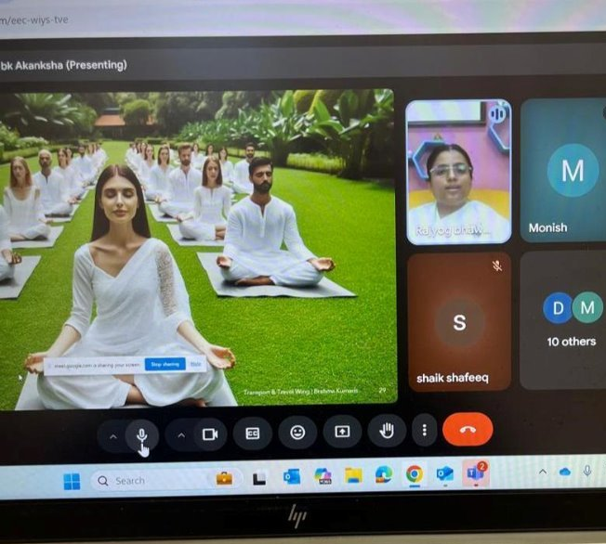
Session 9
Special virtual session on Suhana Safar
Venue - Frido company
Date - 19th April
Speaker - Bk Akanksha bahen
People - 20+ managers, Sales team members
Special thanks to Ravi bhaiji for Permission

Slide 11
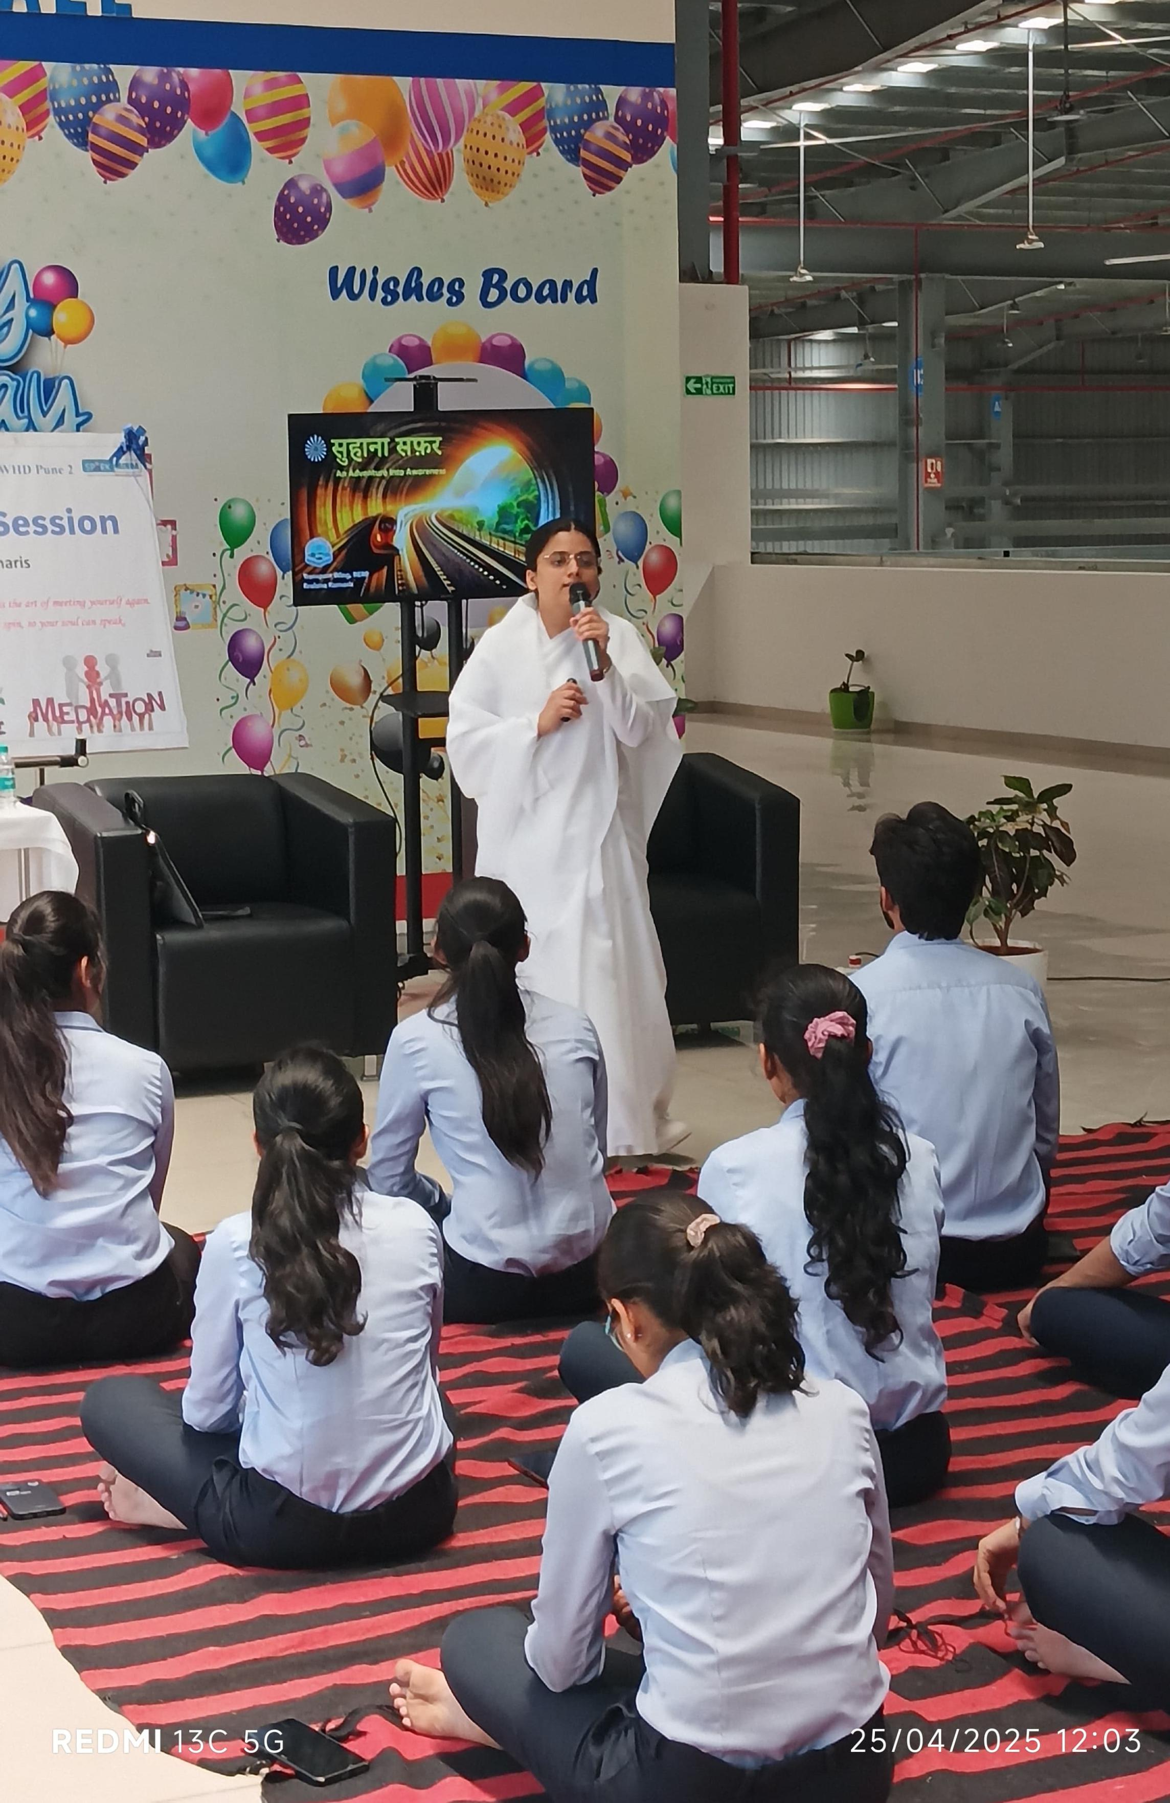
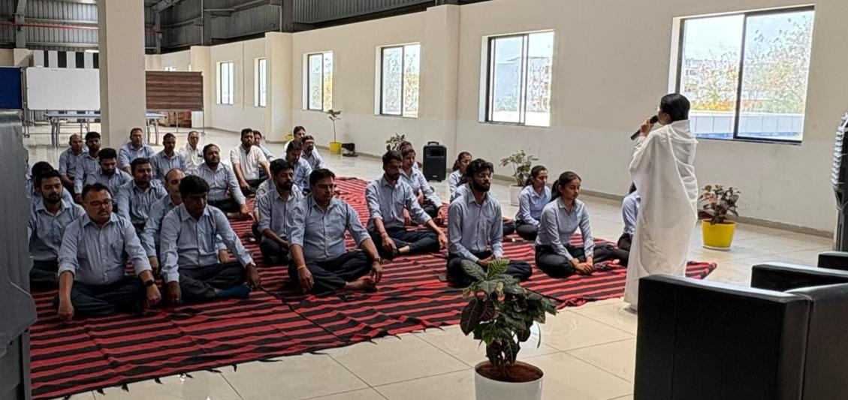
Session 10
Special session on Suhana Safar
Venue - Spark Minda corporation Ltd, company
Date - 25th April
Speaker - Bk Akanksha Bahen
People - 40+ managers
Sevadhari - Bk Gopal bhai

Slide 12
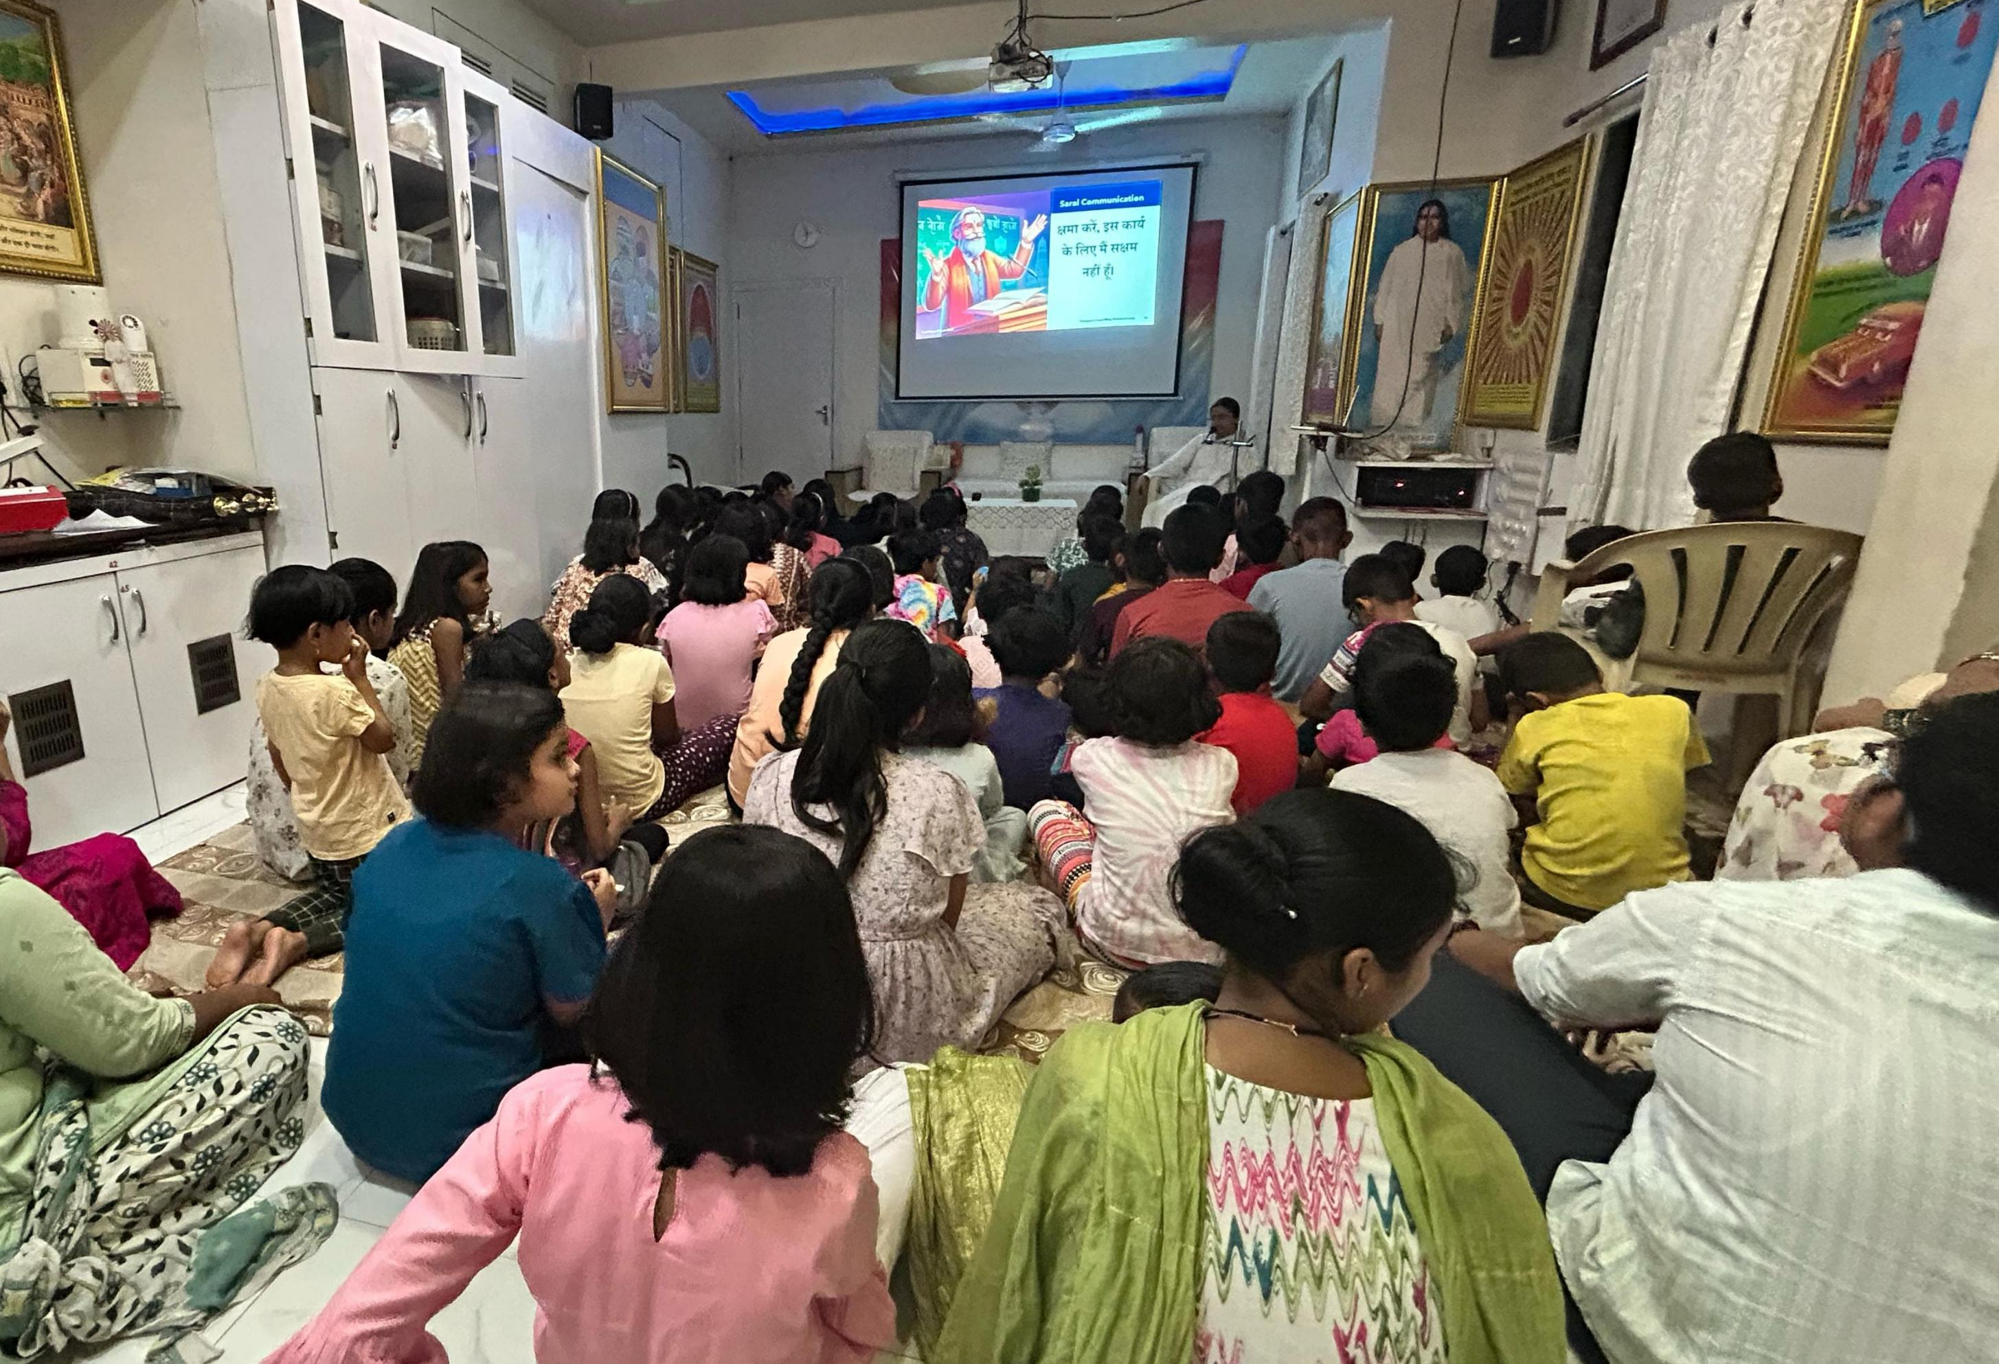
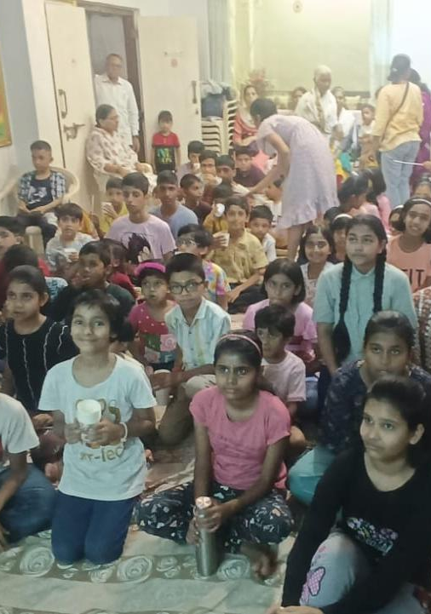
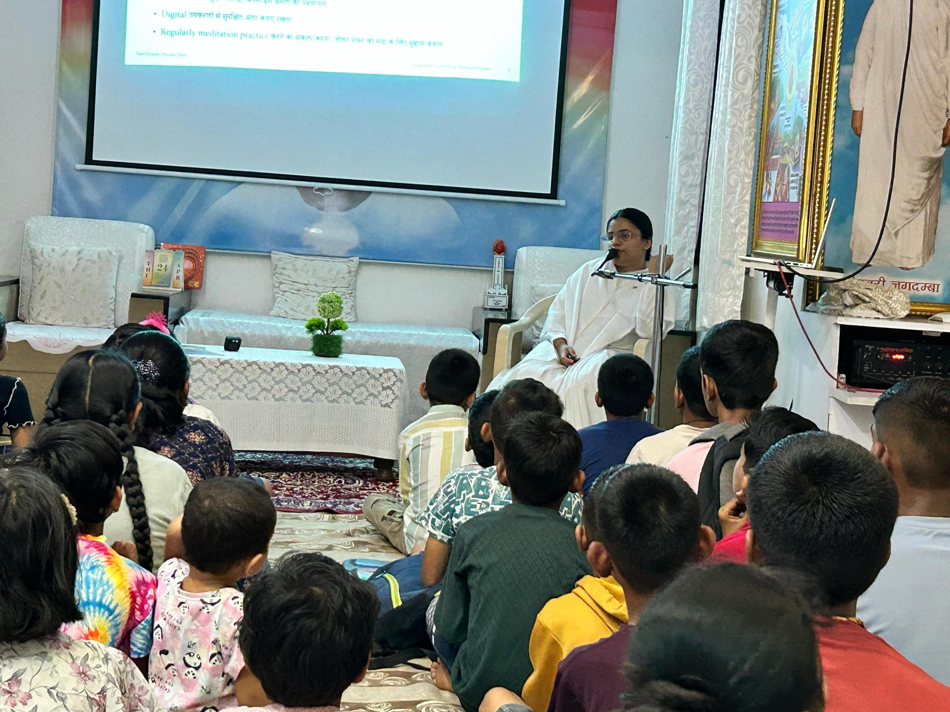
Session 11
Special session on Suhana Safar conducted in the Children summer camp
Venue - Rajyog Bhawan Chinchwad
Date - 28th April
Speaker - Bk Akanksha
People - 70+ kids

Slide 13
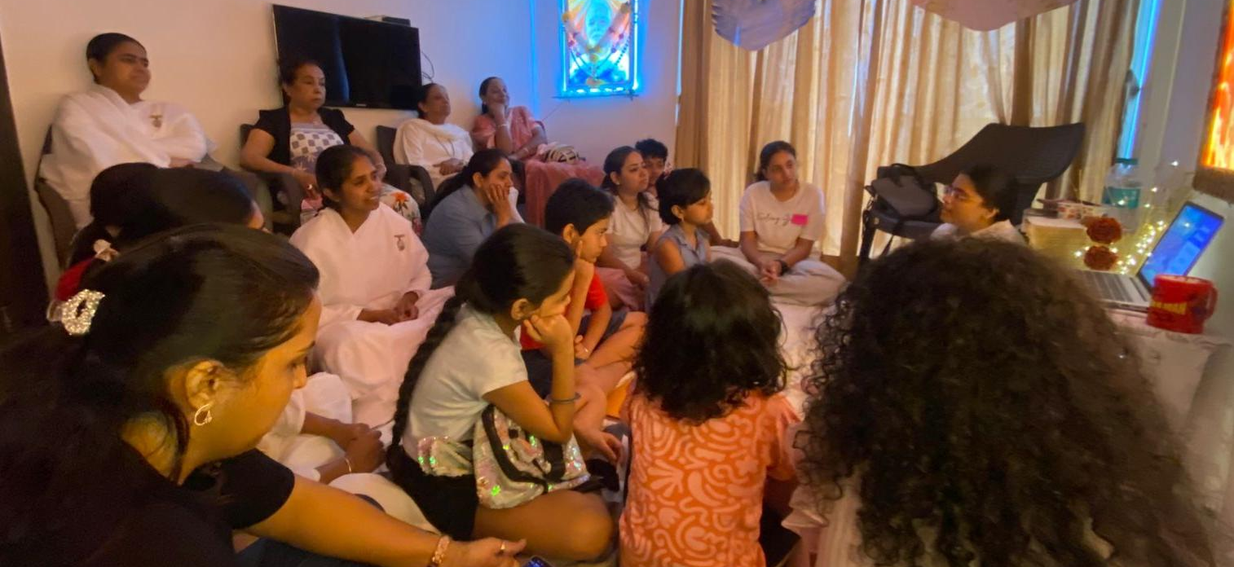
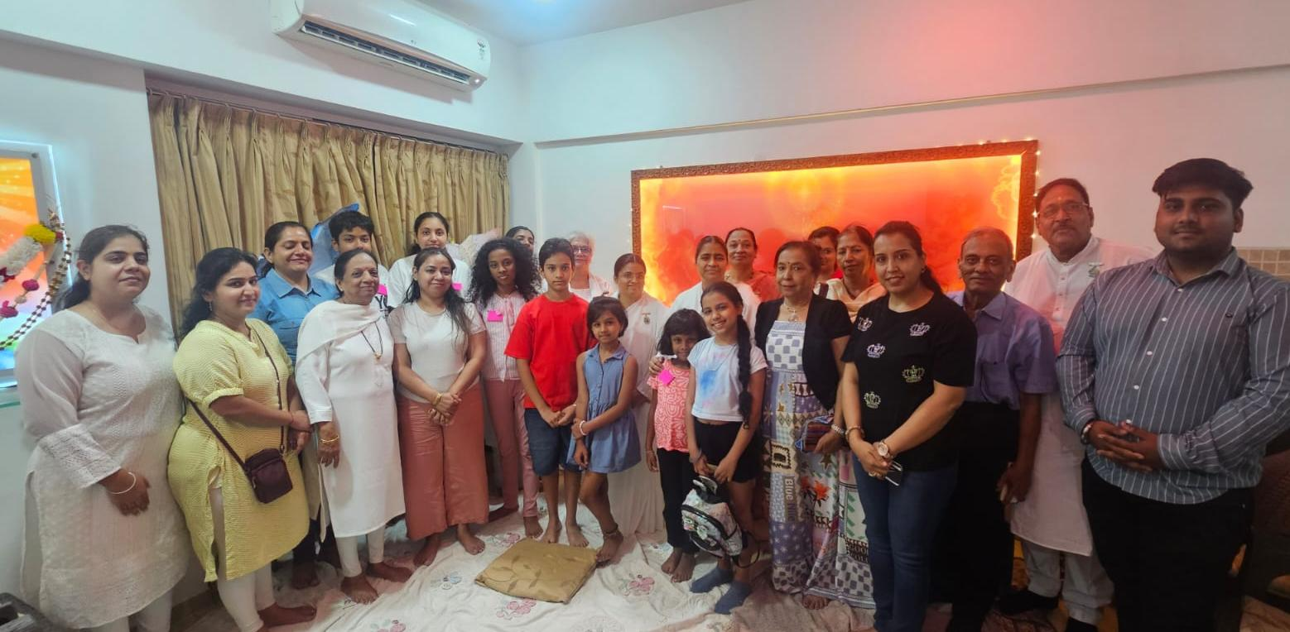
Session 12
Venue - Lodha Belmondo Society
Date - 9th May
Speaker - Bk Akanksha
People - 28+ kids and parents
Subject - Suhana safar
Special thanks to Surekha didiji (Pimpri Centre, in-charge,Quarter Gate subzone) for invitation and Ravi bhaiji, Rita mataji for arranging session

Slide 14
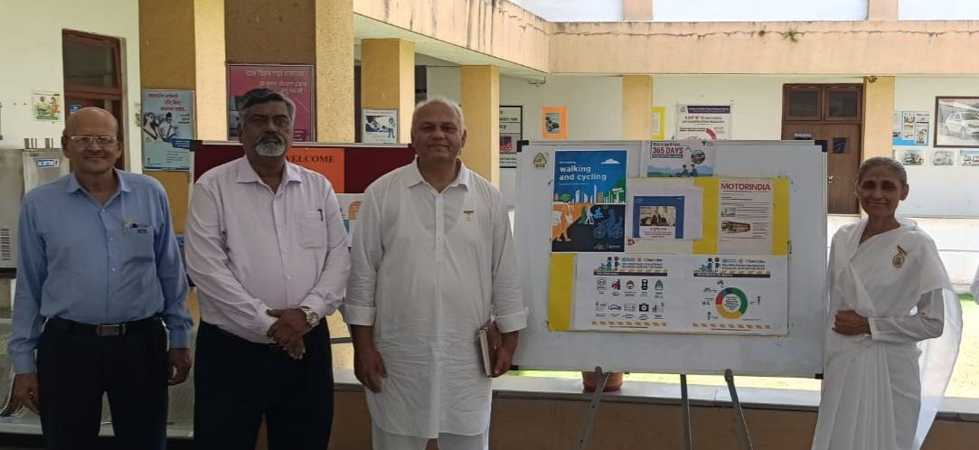
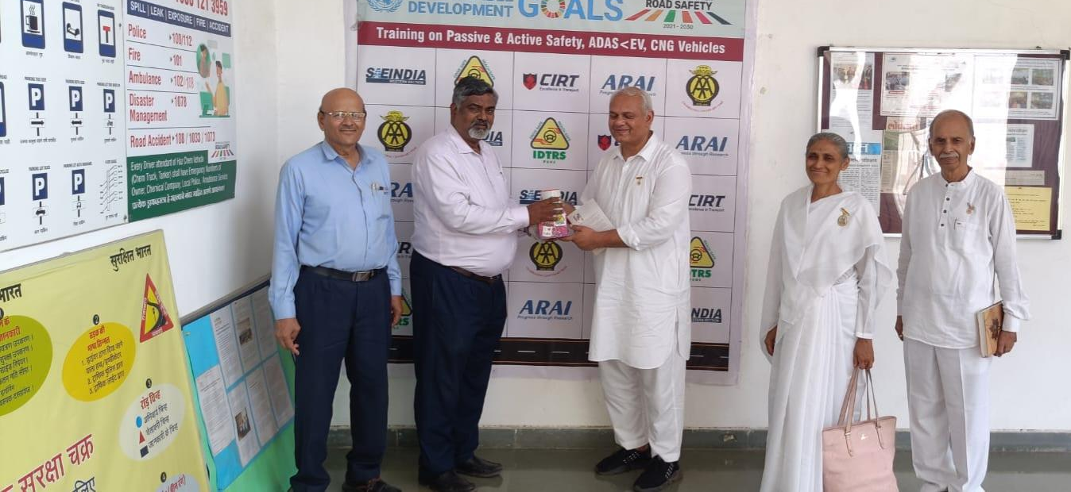
Session 13
Special Visit to IDTR
Date - May 17, 2025
Venue - Institute of Driver’s Training and Research Society (IDTRS), Kasarwadi
Invitation by – Principal Shree Sanjay Sasane to Mukul Bhaiji
The Principal and his team gave presentations on various activities of the institute.
During the discussion, it was agreed to arrange some regular sessions with the help of Brahma Kumaris.
Participants – BK Ashwini (Chinchwad Centre Incharge) and BK Manvendra Bhai

Slide 15
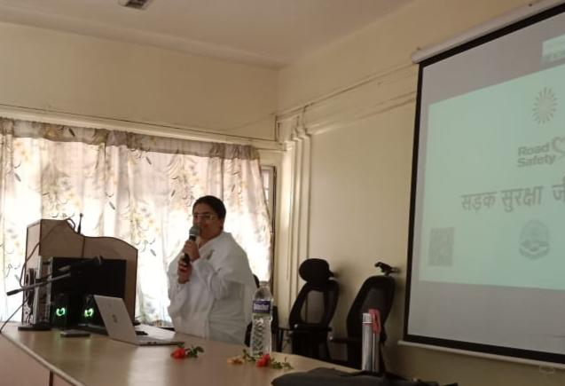
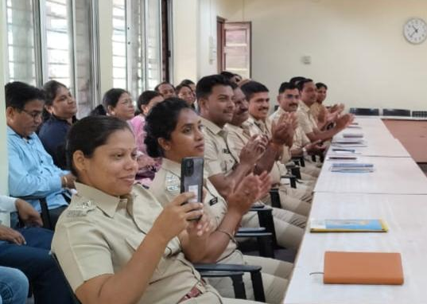
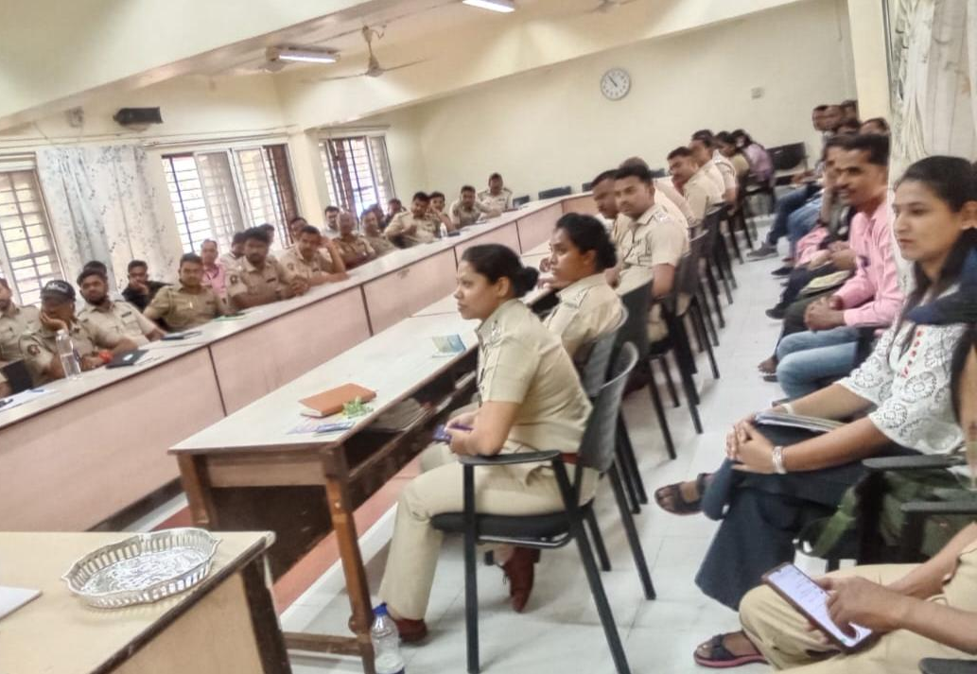
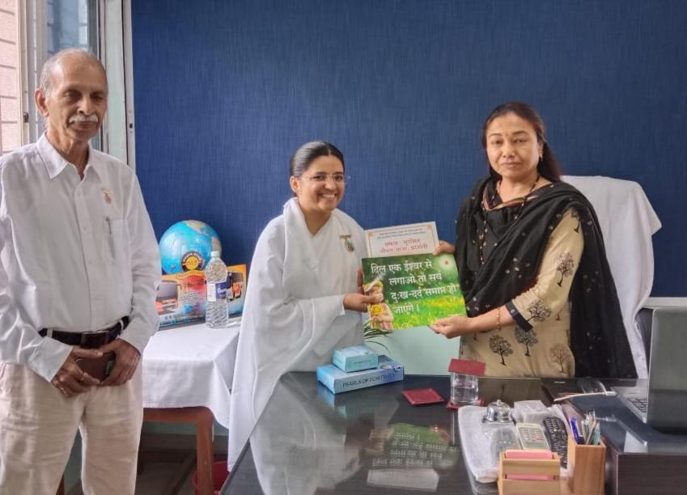
Session 14
Special session on Suhana Safar
Venue-Maharashtra State Road Transport Corporation
Date - 19th may
Speaker - Bk Akanksha bahen
People - 60+ Road Transport accident Inspectors from whole Maharashtra (1/2 from every district)
Sevadharis - Bk Manvedra Bhaiji
We also invited Depo Head for Transport wing conference at Mount Abu

Slide 16
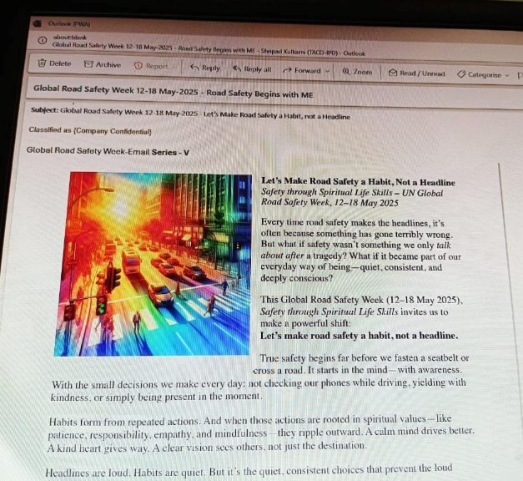
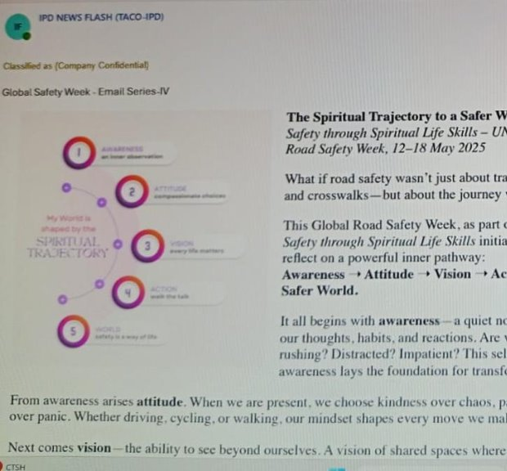
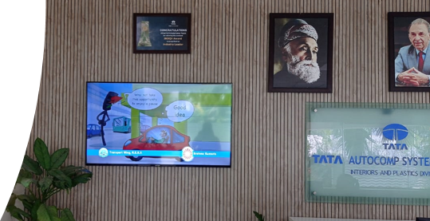
Session 15
Special E-mail campaign on the occasion of Global road safety week
Date –12th to 19th May
Venue -Tata Autocomp company
Safety awareness spread to employees through E-mail & Animated Videos
Special thanks to HR team of company, Shripad bhaiji and Transport travel wing of Brahma Kumaris

